Slide 1
Cold Weather Camping
Mark Firth
Assistant Scoutmaster Troop 352
Minsi Trails Council
Bethlehem, PA
Wood Badge Course NE-V-141

Slide 2
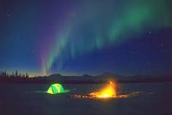
Winter Camping
Exploring the wilderness in winter is a wonderful experience. You are far from crowds, in a hushed tranquil world of white. Whether gliding through a glade of maple trees on cross-country skis or hiking up a ridge on snowshoes, winter can be a spectacular time of year. Camping in the winter inspires a feeling of independence and gives people confidence in their survival skills. Winter camping is an activity that requires planning and preparation, physical stamina, the right equipment, an adventuresome spirit and a positive mental attitude.
This program will provide you with information to earn the Order of the Arrow “Below Zero Camper Award”

Slide 3
Course Overview
How the body regulates heat
Loss of body heat
Insulation
Types of cold
Cold weather first aid
The body and clothing
The layering principle
Trip planning
Winter shelters
Sleeping bags
Foam pads
Setting up camp
Bedding down for the night

Slide 4
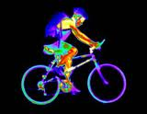
How the body regulates heat
The body basically acts as a furnace, producing heat through chemical reactions and activity. As physical activity increases so does heat production and conversely as activity decreases to does heat production.
Homeostasis: The body’s process for maintaining an even temperature. Arms and legs are used as a radiator to remove excess heat from the body. This process dilates the blood vessels, allowing more blood to flow to the skin surfaces.

Slide 5
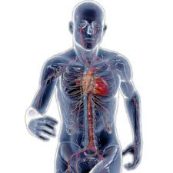
In cold weather, the body temperature drops. The blood vessels constrict, decreasing blood flow, and thereby heat loss. The heart can send less blood to the feet and hands so they become numb.
Since your brain needs oxygen to function, your body can’t cut off the flow of blood to your head in order to conserve heat. Consequently, much of your body heat can be lost through an uncovered head and neck.

Slide 6
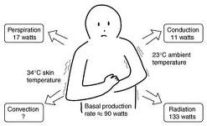
4 ways the body looses heat
Radiation: (55%) A major source of heat loss. Heat is lost directly from exposed skin and the head.
Evaporation: (21%) Loss from evaporation of sweat, moisture from the skin and lungs.
Convection: Heat is lost from the wind carrying away heat from the surface of the skin. Wind chill effect.
Conduction: (15%) Heat is lost through skin in contact with cold objects primarily wet clothes or gloves

Slide 7
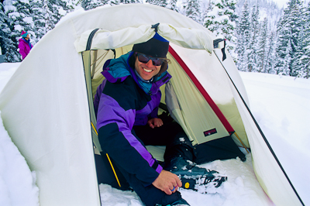
The most important thing to remember about cold weather camping is to KEEP DRY. Moisture will reduce the insulating properties of almost everything. To keep yourself warm remember the word COLD
C – Keep yourself and your clothes CLEAN
O - Avoid OVERHEATING
L- Wear clothes loose and in LAYERS
D – Keep DRY

Slide 8
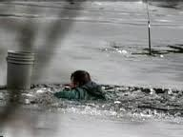
Cold weather emergency
Scene #1
You are hiking along Lake Stillwell in the winter. You notice some ice fisherman on the lake then suddenly you hear a splash and a yell. What kind of heat loss is caused by this situation?

Slide 9
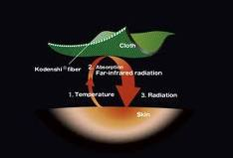
Insulation
The thermal insulation in clothing is proportional to the thickness of the dead air space enclosed. The dead air next to the skin is heated up by the body and provides a layer of warmth around the body. Remember, your body is the heat source, the clothing layers only serve to trap the heat and slow down your heat loss to the cold environment.

Slide 10
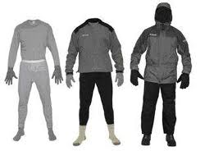
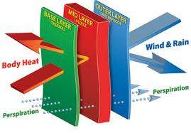
3 layers of clothing
Body heat is trapped in the dead air space while perspiration is wicked away from the skin and through to the outer layer. Wind and rain cannot penetrate the outer layer.
The three layers of clothing:
Base Layer
Mid-Layer
Outer Layer

Slide 11
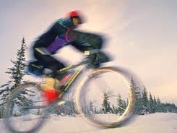
Sweating through your clothes can lead to heat loss and dehydration
Activities in winter is a constant process of adjusting your layers to keep comfortable. This means having layers to add or subtract depending upon the level of activity you are engaging in. You want to control your layers so as to be warm at the activity level you are in but not sweating profusely.

Slide 12
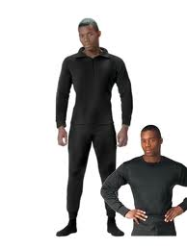
Base Layer or Wicking Layer
This is the layer closest to your skin that wicks moisture away.
This can be a natural fiber like wool or a synthetic fiber. Synthetics work well because they dry faster than wool and last longer. Some synthetic fiber materials actually help reduce odor.
One synthetic fiber called Polypropylene is a plastic fiber that moves moisture away from the skin so it can evaporate.
Socks: Socks should be of the same polypropylene or like material with a wool sock overtop. Keep your feet dry by using foot powder with aluminum hydroxide.

Slide 13
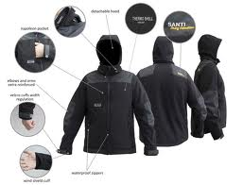
Insulating Layer
This layer traps warm air that your body has heated up. Polar fleece or a Quallofil or Polarguard garment is often used as this mid-layer. Make sure your clothing fits loosely to optimize it’s insulating properties. A sweater may be appropriate here as second layer as well. This is the layer that can be shed quickly if your level of activity rises and you begin to overheat. Remove it and stuff it into your backpack. When you return to camp and your activity level decreases you will want to put it on again.

Slide 14
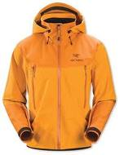
Outer or Protective Layer
Next to the wicking layer, this is the most important part of your clothing system. The outer layer protects the two inner layers from wind, rain and snow. The best type of fabric is Gore-Tex or another waterproof and breathable material. It must shed water yet be breathable to let perspiration evaporate.

Slide 15
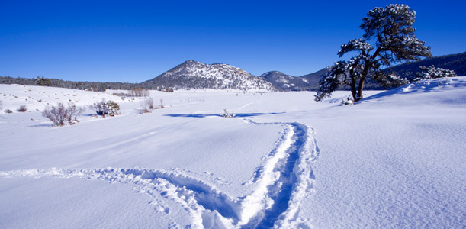
Hiking in paradise
Scene #2
You started out hiking along a marked trail in the mountains. By noontime the weather changed and snow came in. You decide to hike on to reach the next shelter. In a short time, you can no longer see the trail. Now the wind has come up and erased your tracks heading back where you came. Your cotton shirt is wet with perspiration from your exertion. What are some things you need to consider and possible courses of action to take?

Slide 16
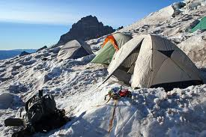
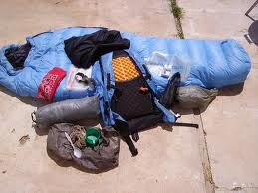
Trip planning and equipment

Slide 17
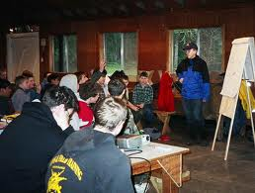
Planning Basics
The first thing you need to do in planning any trip is to educate yourself about:
The area you are traveling
The conditions you may likely encounter
Learn about possible hazards
Acquire the proper equipment
Be physically prepared
Leave a detailed trip plan with a responsible individual (the cardinal rule of backcountry travel)

Slide 18

Educate yourself about the area, skills and equipment you need for your visit
Some good sources of information are:
National Park Service Rangers
Local Trail or Camping Organizations
More experienced hikers
Travel or hiking guides
Maps and guide booklets
BSA Field Guide
Internet web sites, blogs and discussion boards devoted to winter camping
www.wintercampers.com
Books from the library such as Backpacker’s “Winter Camping Handbook: Managing Cold for Comfort and Safety by Michael Lanza

Slide 19
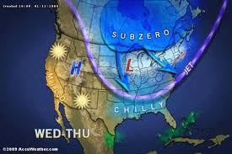
Learn about current weather conditions
Pay attention to the local forecast for weather updates
Avoid outdoor activities in unsafe or hazardous weather conditions

Slide 20
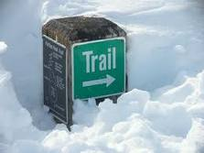
Consult maps and know your way
In winter, it will take you longer to reach destinations in the snow than on dry ground. Plan that your trip will take longer and that sunlight will be shorter. You have to prepare for camp earlier in the day.
Trail markers may become buried and harder to locate and the trails indistinct from the surrounding area. A compass is essential equipment

Slide 21
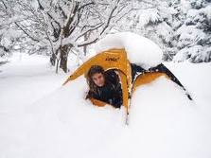
Types of Cold
Wet Cold – 50 degrees to 14 degrees. The most dangerous type of cold. Damp conditions from melting snow or rain make keeping dry difficult
Dry Cold – 14 degrees to negative 20 degrees. Ground is frozen and snow is dry and crystallized. Strong winds cause the most concern with keeping warm.
Arctic Cold – Below negative 20 degrees. Requires the most insulation and wind-proofing. Many materials change physical properties and become brittle. Only for the most experienced campers.

Slide 22
Cold Weather First Aid
Dehydration is excessive loss of body water. Impairs the ability to reason so the victim does not act properly.
Prevention: Drink at least 2 quarts of water per day
Treatment: Mild cases – drink liquids and keep warm
Severe cases require immediate medical attention
1-5% deficiency: Increased pulse rate
Nausea and loss of appetite
Dark urine
Irritability and fatigue
Thirst
6-10% deficiency:
Headaches and dizziness
Labored breathing
Tingling
Absence of salivation
Inability to walk
Blue or grayish skin color
11-20% deficiency:
Swollen tongue, inability to swallow
Dim vision, deafness
Shriveled, numb skin
Painful urination
Delirium, unconsciousness and death

Slide 23
Cold Weather First Aid
Hypothermia is the lowering of the inner core temperature of the whole body – known as the silent killer because most cases happen in temperatures that are higher than freezing
Causes: Wet skin and clothing will accelerate heat loss, and cause the body to cool especially in windy and cold conditions
Predisposing Conditions:
Poor physical condition
Inadequate nutrition and water intake
Non protective clothing
Getting wet
Inadequate protection from wind, rain and snow
Exhaustion
Treatment:
Moderate Cases: Get as sheltered as possible and remove wet clothing. Replace with dry clothing and put patient into a warm sleeping bag with another person. Give warm fluids with sugar. Get help
Severe Cases: Individual requires very gentle handling. Cut away wet clothing and wrap in warm, dry blankets. Person may not seem to be alive. Begin CPR. Get help
Stages of Hypothermia
95-95 degrees – Sensation of chilliness, numbness, shivering begins
95-93 degrees – muscle incoordination, slow stumbling pace, mild confusion, skin pale and cold to touch
93-90 degrees – pronounced muscle incoordination, inability to use hands, slow thought and speech, amnesia
90-86 degrees – shivering stops, muscle incoordination with stiffness and inability to walk or stand, confusion, irrational thoughts
86-82 degrees – muscular rigidity, dilatation of pupils, skin ice cold, inapparent heartbeat and pulse
82-78 degrees – unconsciousness and death

Slide 24
Cold Weather First Aid
Frostbite is tissue injury involving the actual freezing of the skin and underlying tissues
Predisposing Conditions:
Prolonged exposure to temperatures below 32 degrees
Exposed body parts
Restriction of circulation
Fatigue, poor nutrition, low liquid intake, poor physical condition
Prevention:
proper clothing
use buddy system to check ears, nose and face
immediate treatment for minor symptoms
maintain core temperature
Symptoms:
First Degree – Pain, redness, stinging sensation, skin may look blotchy,
Second Degree – No pain, numbness, skin is hard to the touch
Third Degree – Full thickness of skin involved
Fourth Degree – Skin and bone are frozen, swelling and sweating occurs, amputation may be necessary
Treatment:
Check for hypothermia
Exercise the affected area to promote blood circulation
Don’t rub skin with snow or hold over a fire. Gentle warming only
Don’t try to thaw out affected area in the field, accompanying pain will not allow person to walk out.
Obtain immediate medical help

Slide 25
Cold Weather First Aid
Snow Blindness is inflammation of the eye caused by exposure to reflected ultraviolet rays when the sun is shining brightly on an expanse of snow.
Prevention : wear glasses when any danger is present. Do not wait for discomfort to begin
Symptoms: Sensation of grit in the eye, made worse by eye movement, watering, redness, headache and increased pain with exposure to light
Treatment: blindfold the patient or cover eyes with the darkest glasses. Eyes heals in a few days without permanent damage

Slide 26
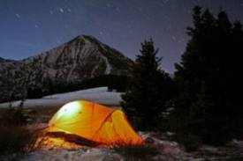
Selecting a camp site
Wind: Avoid ridge tops and open areas where wind can blow down tents or create drifts
Be aware of “widow makers” dead branches overhead
Avoid low lying areas where the coldest air will settle
Level ground
Exposure: Southern facing areas will allow maximum sunlight
Set up your tent opposite of the prevailing winds
Stake tents out
On a cold night, mound snow along the outside walls of the tent to provide more insulation
Keep snow and ice out of your tent sweep it out with a wisk broom
Accumulated snow can collapse a tent roof, dome tents are superior as they allow snow to slide off

Slide 27
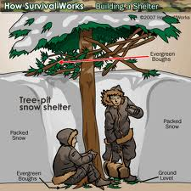
Survival Shelters
Tree Pit Snow Shelter: Is the simplest to construct
Evacuate snow to ground level and use evergreen boughs to cover the bottom for insulation

Slide 28
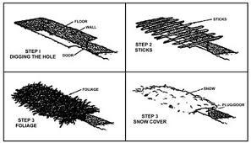
Constructing a snow trench
Dig a trench in the snow to ground level a little longer than your body and about 3-4 feet wide.
Line the bottom with insulating material to protect you from the ground.
A roof can be made of poles or natural materials then covered with a tarp and then snow.
A ventilation hole must be poked into the roof for air flow.
If possible the entrance should be lower than the level of the trench; this keeps the cold air at the entrance rather than in the trench.

Slide 29
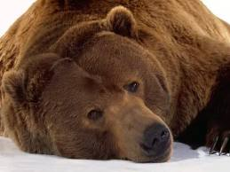
Bedding down
Wear a stocking cap to bed to preserve heat loss
Use a closed cell foam sleeping pad at least ½ inch thick beneath you to help prevent heat loss from the ground. Newspapers can help add a layer of protection from the ground
Use a ground cloth to keep ground moisture from your bag
Air out your sleeping bag and tent. Perspiration and breath condense in the tent at night and the water will reduce insulating properties of your bag
Remove clothes your are wearing before bedding down if they are damp with perspiration. Put on dry clothing before entering your sleeping bag

Slide 30
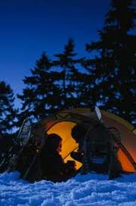
Other tips
Do not sleep with your head inside the bag, your breath will increase dampness
Wear a loose fitting hooded sweatshirt to bed
Increase the effectiveness of your sleeping bag by adding a blanket inside or putting one sleeping bag inside another
Wrap your coat around the outside of your sleeping bag at your feet
Fill a metal canteen with hot water and place at the foot of the bag to keep warm
Instead of getting out of the tent at night pee in a bottle and discard in the morning
Eat a protein snack before bed to increase metabolism. If you wake up at night, eat a protein snack
It’s useful to have a thermos of hot drink at night
Don’t use flames in a tent or use any stoves that can lead to carbon monoxide poisoning

Slide 31
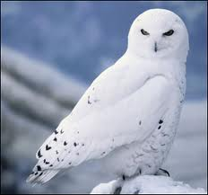
Credits:
Cold Weather Camping
http://www.netwoods.com
Survival Topics
http://survivaltopics.com
Outdoor Action Guide to Winter Camping
http://www.princeton.edu/oa/winter/wintercamp.shtml
BSA Field Guide
BSA Okpik Cold Weather Camping

Slide 32
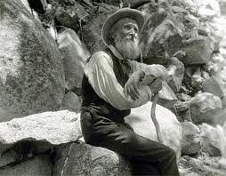
Consider these thoughts of naturalist John Muir
Keep close to Nature's heart... and break clear away, once in awhile, and climb a mountain or spend a week in the woods. Wash your spirit clean.
Wander a whole summer if you can. Thousands of God's blessings will search you and soak you as if you were a sponge, and the big days will go by uncounted. If you are business-tangled and so burdened by duty that only weeks can be got out of the heavy laden year, give a month at least. The time will not be taken from the sum of life. Instead of shortening, it will indefinitely lengthen it and make you truly immortal.

